Slide 1


Slide 2
Psalms 137
“1 By the rivers of Babylon, there we sat down, yea, we wept, when we remembered Zion.
2 We hanged our harps upon the willows in the midst thereof.
3 For there they that carried us away captive required of us a song; and they that wasted us required of us mirth, saying, Sing us one of the songs of Zion.
4 How shall we sing the Lord’s song in a strange land?
5 If I forget thee, O Jerusalem, let my right hand forget her cunning.
6 If I do not remember thee, let my tongue cleave to the roof of my mouth; if I prefer not Jerusalem above my chief joy.
7 Remember, O Lord, the children of Edom in the day of Jerusalem; who said, Rase it, rase it, even to the foundation thereof.
8 O daughter of Babylon, who art to be destroyed; happy shall he be, that rewardeth thee as thou hast served us.
9 Happy shall he be, that taketh and dasheth thy little ones against the stones.”

Slide 3
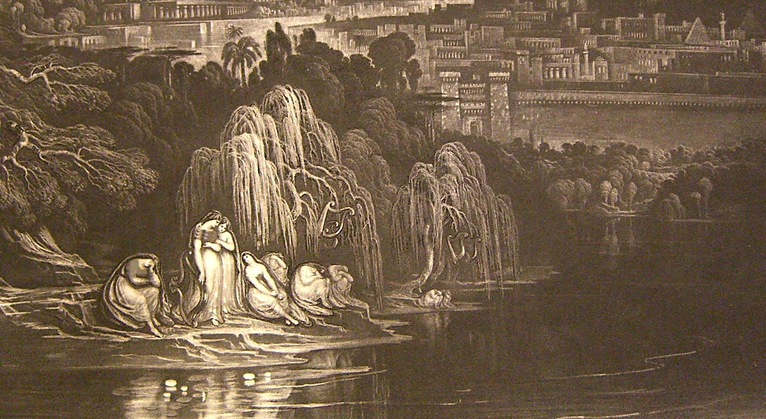
Lamentations 2:21
“The young and the old lie on the ground in the streets: my virgins and my young men are fallen by the sword; thou hast slain them in the day of thine anger; thou hast killed, and not pitied.”

Slide 4
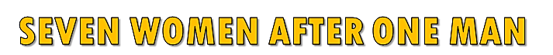
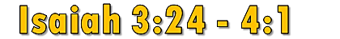
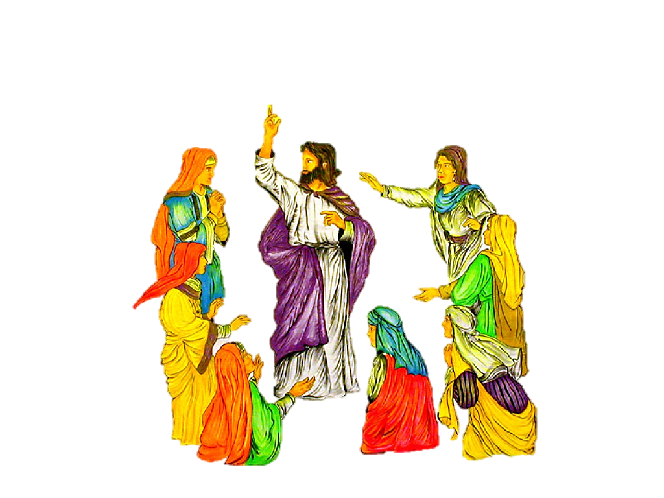
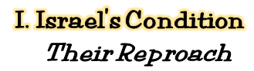
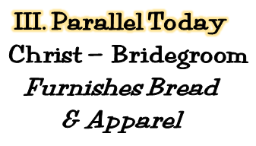
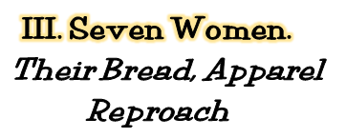
Christ – One Bride – Church
Eph. 5:23-25; 4:4; Col. 1:18
God’s Plan: One Wife—Matt. 19:3-8
Polygamy’s Origin—Gen. 4:19
4
Mormon Church
Roman Catholic Church
Seventh Day Adventist
Church
Lutheran Church
Methodist Church
Pentecostal Church
Baptist Church

Slide 5
THE GOSPEL PLAN OF SALVATION
Hear the Gospel
Acts 2:22
Believe the Gospel
Acts 8:37a
Repent of Sins
Acts 2:38
Confess Christ
Acts 8:37b
Be Baptized
Acts 2:38
“The Lord added to the church daily” Acts 2:47

Slide 7

By the waters, the waters of Babylon.
We lay down and wept, and wept, for thee Zion.
We remember thee, remember thee, remember thee Zion.
ADDENDUM
For personal edification.
(All parts sung by Jason McDade)
Song will begin in 3 seconds.
To skip song click escape.

